Slide 1
Parents’ Information 2024-2025
Welcome to Year 4

Slide 2
Welcome
The aim of this short PowerPoint is to provide you with the expectations in Year 4 and other information so that your child is fully prepared. If you have any further questions after this please do not hesitate to contact us in person by making an appointment out of teaching hours or through the school office via phone call or email.
Phone: 02085992263 (please leave a message and we will return your call out of teaching hours)
EMAIL: office@mayespark.redbridge.sch.uk
We look forward to your support and cooperation in making this academic year a memorable and successful experience for your child.

Slide 3
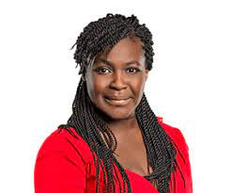
Aderin class Ms Assenjee & Mrs Jabbar
Throughout the school year we will be teaching children about the inspiring people our classes are named after. Please do your own research at home with your child to support their learning.
My favourite colour is green.
I love reading.
I speak several languages

Slide 4
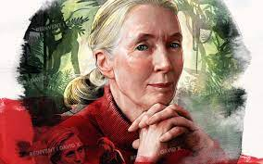
Goodall class
Mrs Razin
I
I enjoy reading and art.
I am very competitive.
I have two children.

Slide 5
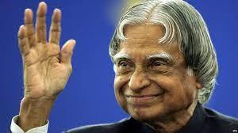
Kalam class
Mrs Sambee
I enjoy art.
I support Liverpool FC.
I love pasta.

Slide 6
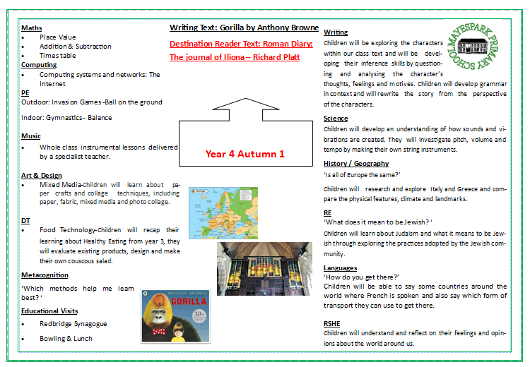
Curriculum
Every half term you will receive an overview of what your child will be learning at school. You may wish to support your child by taking them to the local library to do their own research on some of the topics we will be covering.

Slide 7
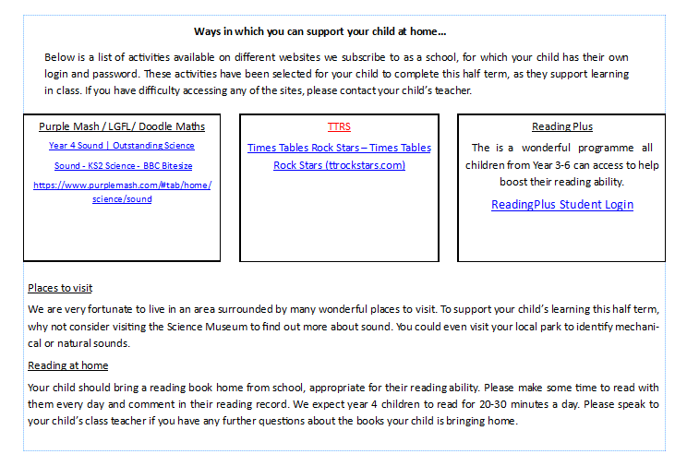
Parental Involvement
A list of ways you can support your child with their learning will also be sent home every half term.

Slide 8
Educational visits
Our aim is for your child to take part in at least one educational visit each half term.
The overview is only an indication. Letters will be sent home to confirm the details. Please let you child’s class teacher know if you are able to accompany them on the visit.

Slide 9
Reading expectations
Children will bring home a book appropriate to their reading level. They should be reading for at least 30 mins each day and signing their reading journals with a comment about the book. A parent or carer should sign their reading journals once a week. Teachers will be checking reading journals every day.
The recommended book list for Year 4 can be found on the Mayespark website.

Slide 10
Homework
We have a consistent approach to homework.
Homework is set on Google Classroom. Each child has a log in but please ask your class teacher if you don’t have one.
Each week their will be a piece of English, maths and spellings to complete.
Please can all homework be completed in the homework books provided.
Homework is set on a Friday and handed in by the following Wednesday.
• Reading should be completed every night (recommended 30 minutes) and recorded in their reading record.

Slide 11
• Learn the Key Instant Recall Fact (KIRFs) for each half-term.
• Any online homework, such as Reading Plus and Times Tables Rock stars, should be completed when set. Opportunities will be provided for children who do not have access to the internet or parents should visit the local library with their children to use the computers free of charge. Children can access these resources independently even when homework is not set.
• Any other topic work/project work should be completed when set (usually over the course of a number of weeks).
Year 4 | We are learning to… | At the beginning… | At the end…
Autumn 1 | To add and subtract multiples of 100.
 | To find pairs of numbers that total 100.
Autumn 2 | To find doubles of numbers to 50 + 50.
 | To recap known multiplication and division facts (4, 8, 3, 6).
Spring 1 | To know multiplication and division facts for the 7 and 9 times tables.
Spring 2 | To know multiplication and division facts to 12 x 12.
Summer 1 | To know pairs of multiples of 50 that total 1000.
Summer 2 | To use multiplication and division facts to find fractions of amounts.

Slide 12
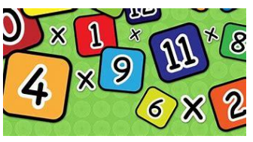
Things your child can do at home:
Practice your times tables! You need them for nearly every Maths topic in Year 4. Chant/say them or play some online games.
Hit the Button - Quick fire maths practise (topmarks.co.uk)
Daily 10 - Mental Maths Challenge - Topmarks
Times tables collection - BBC Teach
Keep reading! Good readers make good writers. Remember: reading can be story books, comics, joke books, information books, song lyrics etc. Try to explore lots of different types and genres.
Work on your handwriting, presentation (including drawing lines,
margins, underlining using a ruler) and punctuation/grammar.

Slide 13
And Finally… Year 4 is going to be a great year. We cannot wait to start our learning journey together with your children. We know there are lots of things to remember and it will be very busy, full of new learning, but we will have lots of fun and laughs along the way! If you have any further questions, please speak to your child’s class teacher. Year 4 Team☺

