Slide 1
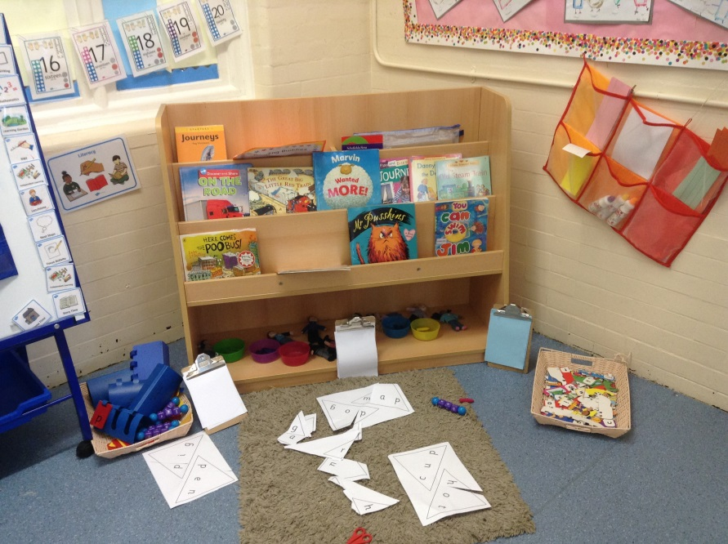
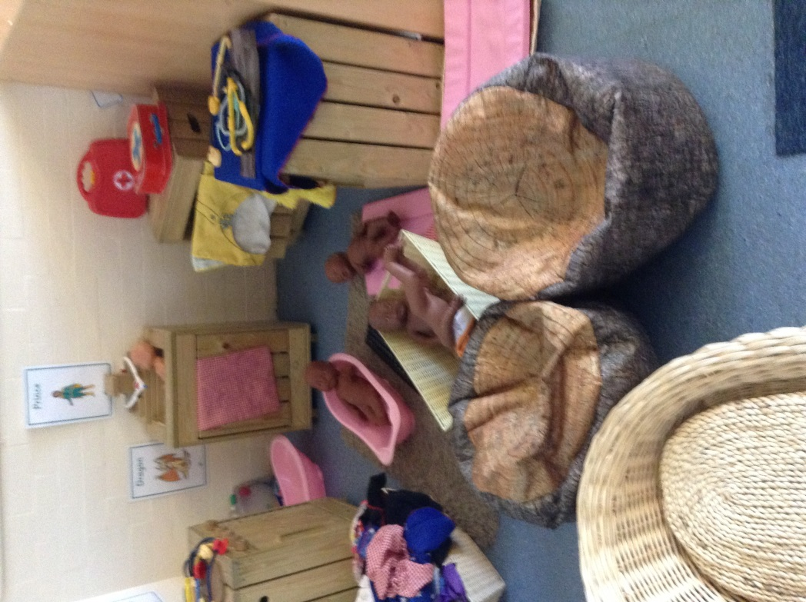
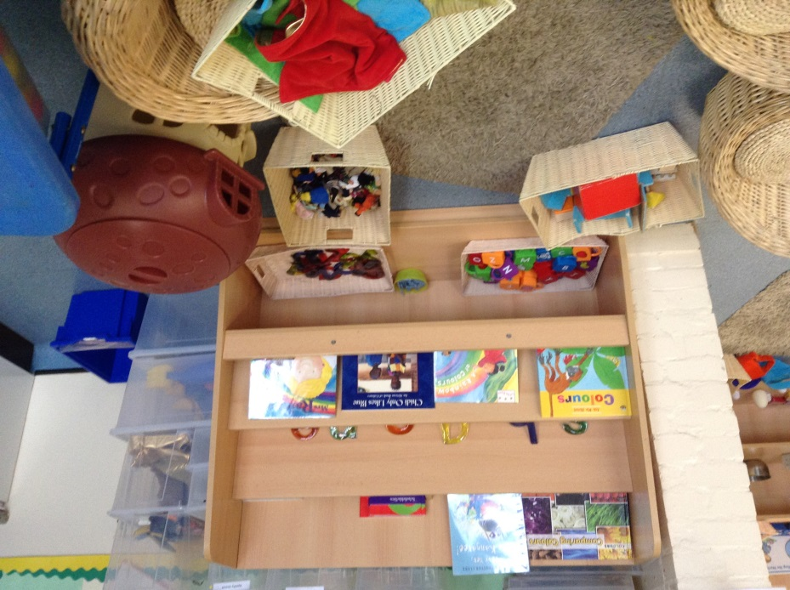
Welcome to Early Years

Slide 2
Curriculum
3 Prime Areas of Learning:
Personal, Social and Emotional Development
Physical Development
Communication and Language
4 Specific Areas of Learning (through which the prime areas are developed and applied)
Literacy
Mathematics
Understanding of the World
Expressive Arts and Design
Notes:
Ruby

Slide 3
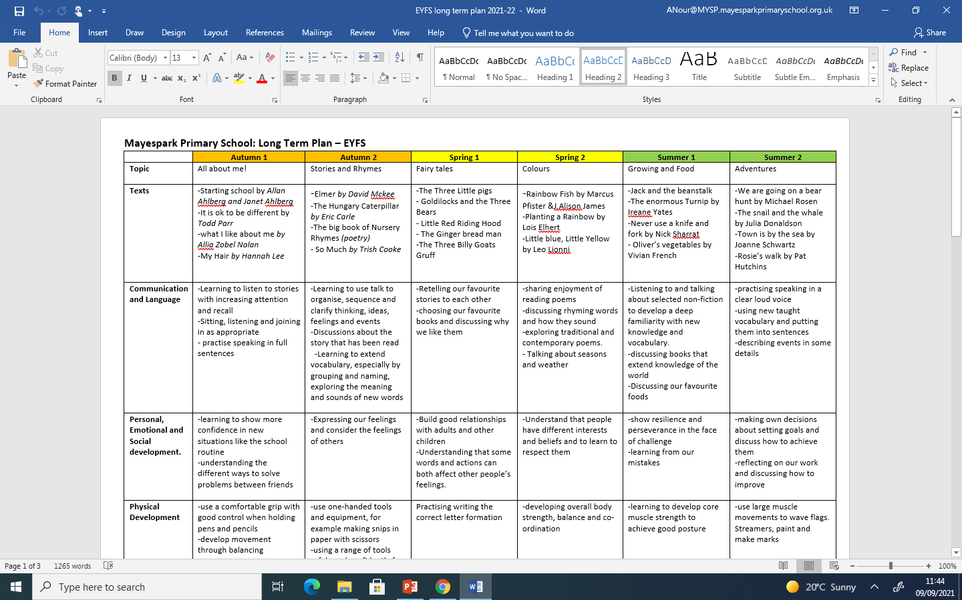
Curriculum
Notes:
Ruby

Slide 4
Big Picture Here you can find information about what we will be teaching your child in each subject.
Notes:
Ruby

Slide 5
Also there are suggestions of ways you can support your child with their learning at home.
Notes:
Ruby

Slide 6
Reading in EYFS.
Throughout the school day your child will have many opportunities to enjoy and listen to stories.
They will be listened to or read to each week by an adult and the teacher will listen to them read . The teacher and adult will record what they have read and make a comment about their reading in their home school reading record.
Notes:
Amira

Slide 7
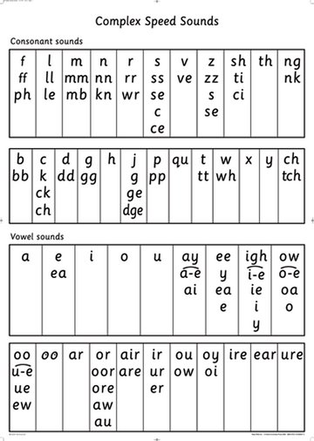
RWI
Everyday your child will have a RWI lesson, where they will continue to learn their sounds and read books that match their phonic knowledge.
Notes:
Amira

Slide 8
Ways to support your child with reading at home.
Each week your child will bring home at least four books.
Two books will be from our book corners that you can share and read together. It is not expected that your child will be able to read these independently but will enjoy sharing a story with you for pleasure.
In addition they will bring home a colour banded book that they will read to you. This is practised daily for at least 15 minutes and a comment made in the reading journal.
The reading journal will be checked each day by the class teacher to check children are engaging and practising reading at home.
Taking your child regularly to the library is a wonderful opportunity to improving their reading. Here they can select books that interest and excite them and develop their passion for reading.
Extend your child’s vocabulary, e.g. instead of saying,” Look at that big dog? ”
We could say “Look over there, can you see the enormous dog wagging its tail? It looks
exhausted and thirsty.”
Notes:
Dal

Slide 9
Reading journals The reading journal will be checked every morning to check that your child has read at home and it has been signed by an adult. Rewards are given each week to children who have read daily at home.
Your child’s reading target will also be in the journal so that they can practise this target at home.
In the reading journal you will find useful questions to ask your child as well as sounds and words to
practise.
Notes:
Dal

Slide 10
Expectations of reading
Notes:
Dal

Slide 11
Recommended reading in EYFS
Notes:
Tehmina

Slide 12
Vocabulary
Notes:
Tehmina

Slide 13
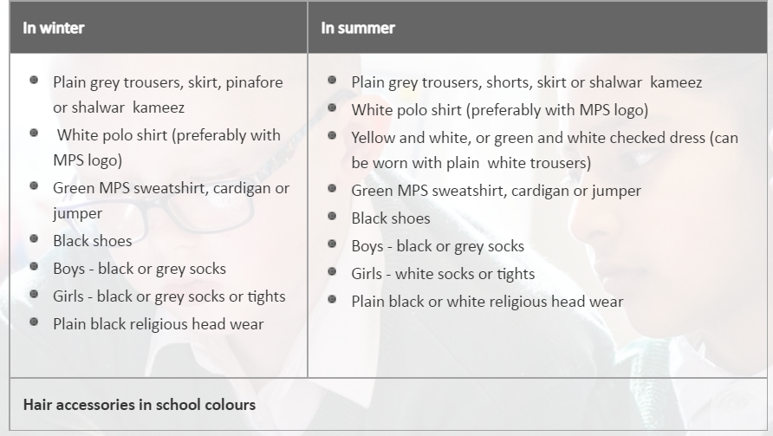
Uniform Expectations
PE Kits
Please ensure PE kits are in school everyday and all uniform has your child’s name on it.
Notes:
Dal

Slide 14
Educational visits
In the Autumn Term we are hoping to visit
Goodmayes Library.
Notes:
Tehmina

Slide 15
Google Classroom -RWI videos -Reading videos -maths videos
Notes:
Amira

Slide 16
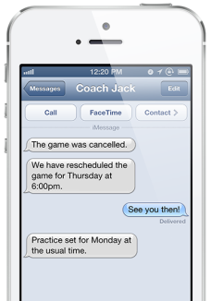
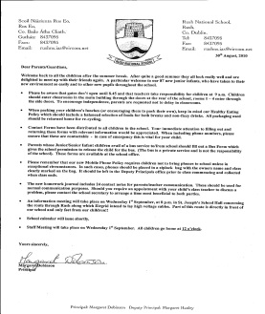
Communication at Mayespark Primary School
School mail
Website
My school app
Group calls
Paper letters
Video message
Notes:
Dal

Slide 17
Communication
Class teachers are always happy to help with any queries.
Please contact the office via email or call to arrange an appointment.
Translation is available for any parents who need this support.
Parents Evening dates will be available on the school calendar.
Notes:
Tehmina

Slide 18
Pupil premium
Early Years pupil premium is funding from the government to
support children’s development, learning and care
Are you entitled to pupil premium?
Bring along your NI number to your child’s induction to apply, if
you haven't already done so
Pupil premium funding entitles you to..
Free school meals
Subsidised educational visits
A free school jumper and book bag
Notes:
Amira

