Slide 1
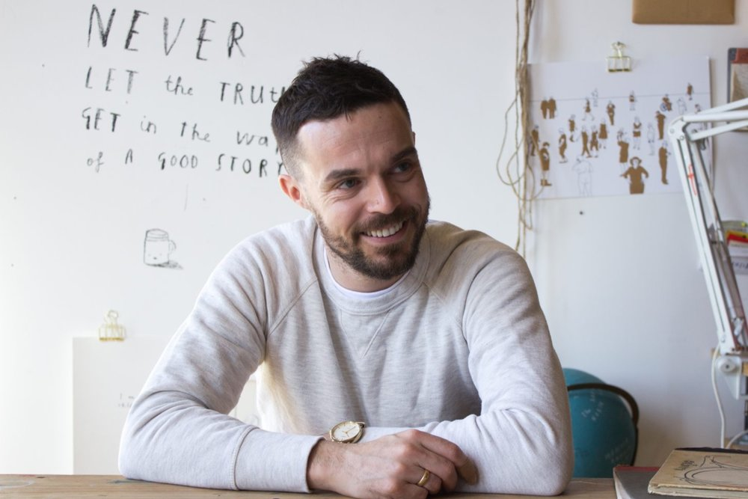
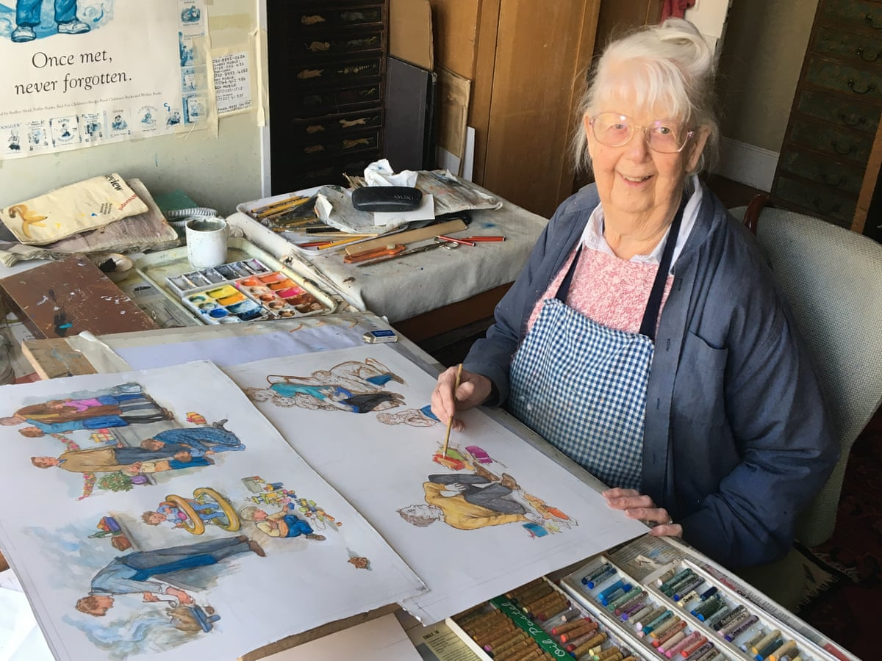
Welcome to Year 1
Jeffers class (Oliver Jeffers)
Miss Zehra
Harrison class (Vashti Harrison)
Mrs Amey and Miss Amran
Hughes class (Shirley Hughes)
Miss Hassan
The children will be learning about their inspirational illustrator during the week,
so please ask them to tell you what they have learnt.

Slide 2
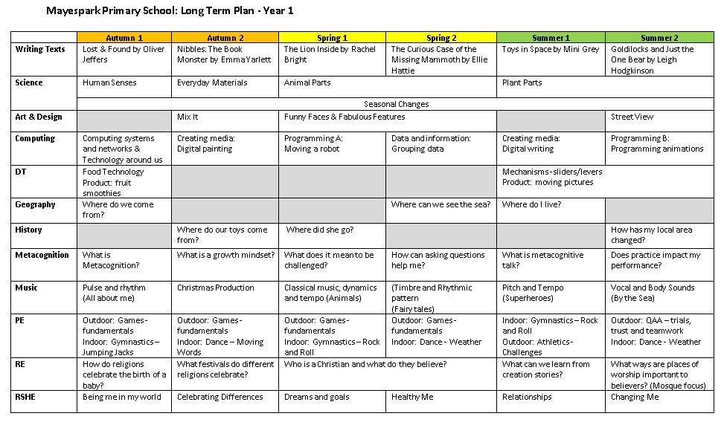
Curriculum

Slide 3
Big Picture Here you can find information about what we will be teaching your child in each subject.

Slide 4
Also there are suggestions of ways you can support your child with their learning at home.

Slide 6
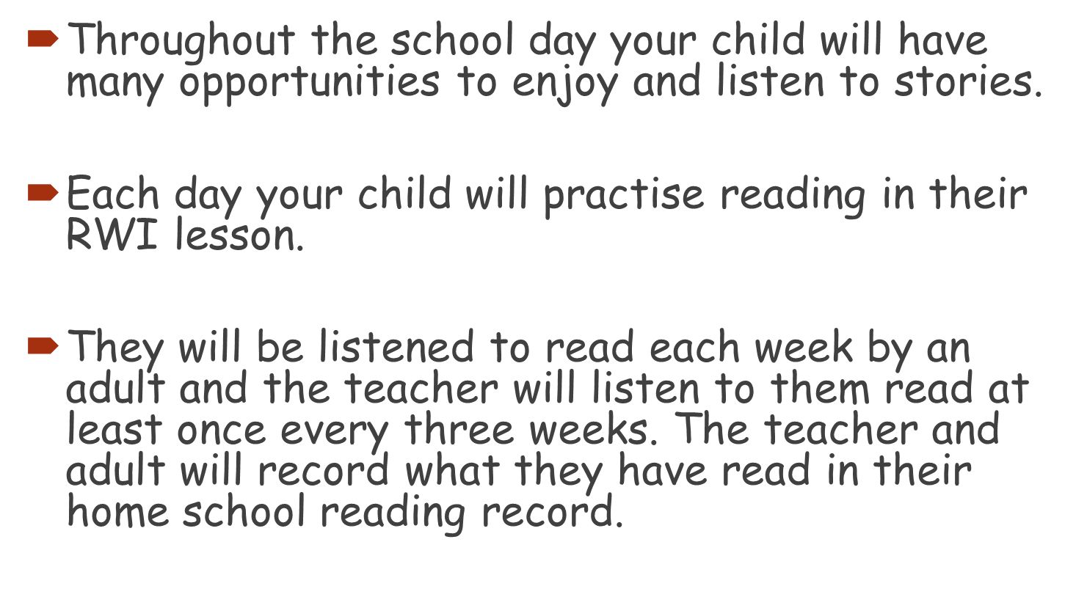
Reading in Year 1

Slide 7
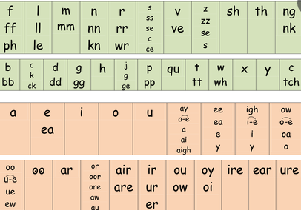
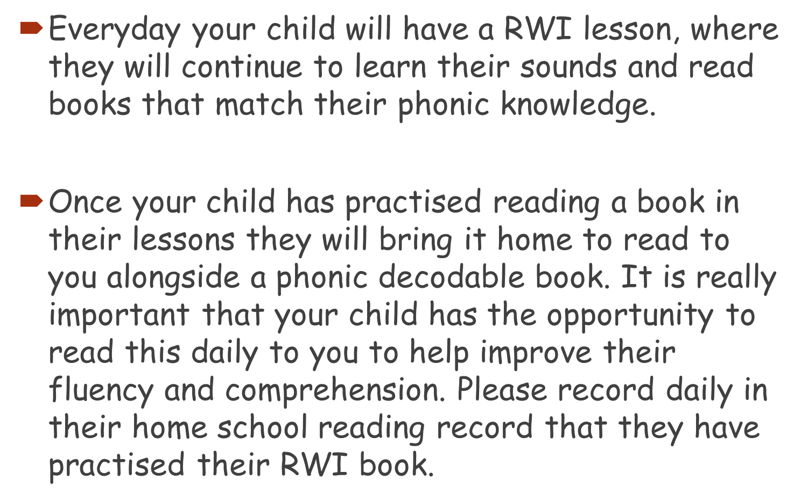
RWI

Slide 8
Ways to support your child with reading at home.
Each week your child will bring home at least two books.
One book will be from our book corners that you can share and read together. It is not expected that your child will be able to read these independently but will enjoy sharing a story with you for pleasure.
In addition they will bring home a colour banded book that they will read to you. This is practised daily for at least 15 minutes and a comment made in the reading journal.
The reading journal will be checked each day by the class teacher to check children are engaging and practising reading at home.
At the end of the week they will bring home a RWI book that they will be excited to read to you at home as they will have been practising this during the week.
Taking your child regularly to the library is a wonderful opportunity to improving their reading. Here they can select books that interest and excite them and develop their passion for reading.
Read with me every Friday. You will receive an e mail with the start day shortly.

Slide 9
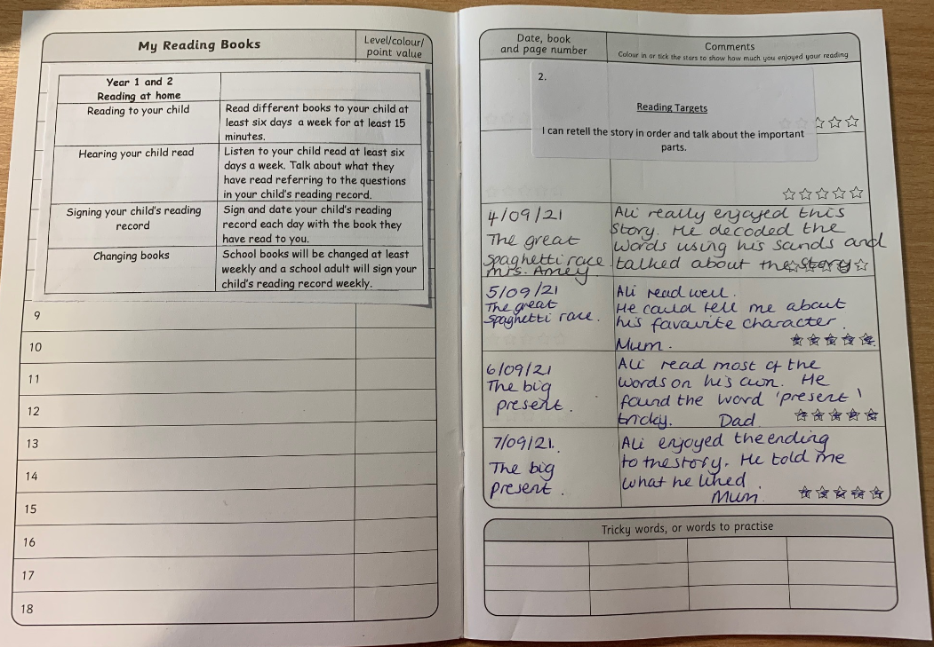
Reading journals The reading journal will be checked every morning to check that your child has read at home and that it has been signed by an adult. Rewards are given each week to children who have read daily at home.
Your child’s reading target will also be in the journal so that they can practise this target at home.
In the reading journal you will find useful questions to ask your child as well as sounds and words to
practise.

Slide 10
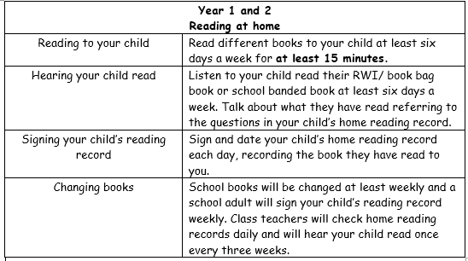
Expectations of reading

Slide 12
Maths in Year 1
Ways to support your child in maths.
Counting forwards and backwards in ones to 20.
Practise writing both the numeral and word e.g. 9, nine.
Playing a variety of games.
https://www.topmarks.co.uk/maths-games/hit-the-button
https://www.ictgames.com/
https://play.numbots.com/
Each week your child will get maths homework which will be a reflection of what they have learnt that week.

Slide 13
Transition in Year 1
We are very aware that the jump from Reception to Year 1 can seem a daunting one. But please don’t worry.
For approximately the first half term, we will be transitioning your children into Year 1 where they will learn new routines and skills whilst still having the opportunity for independent learning through play.

Slide 14
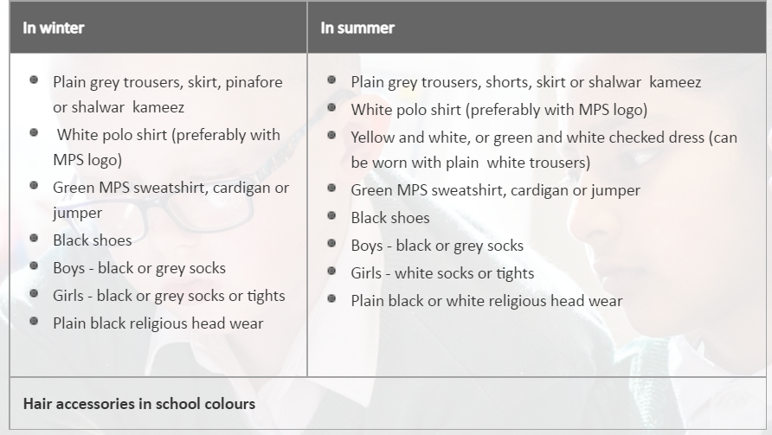
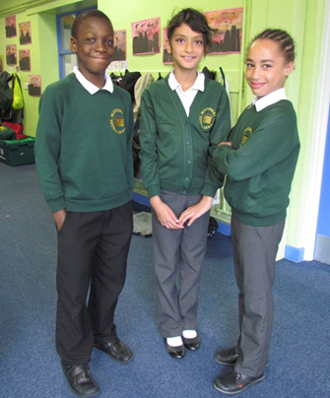
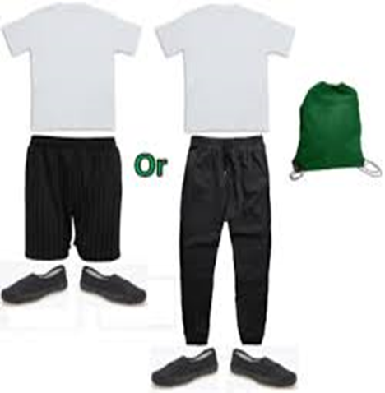
Uniform Expectations
PE Kits
Please ensure PE kits are in school everyday and all uniform has your child’s name on it.

Slide 15
Educational visits
At the end of the Autumn term, we are hoping to visit The Kenneth More Theatre in
Ilford to watch their annual pantomime. We also hope
to take children on a religious educational visit at a local church to
watch a pretend Baptism. There will be more exiting trips planned throughout
the Spring and Summer term.

Slide 16
Homework
Homework is set on Google Classroom each week. Each child has a log in but please ask your class teacher if you don’t have one.
Homework will begin the week starting the 16th September.
Each week their will be a piece of English, maths and spellings to complete
which reflects their learning for that week. Spellings are set by your child’s RWI teacher.
Please ensure that homework is completed in homework books.
Homework is set on a Friday and handed in by the following Wednesday.

Slide 17
Communication
Class teachers are always happy to help with any queries.
Please contact the office via email or call to arrange an appointment.
Translation is available for any parents who need this support.
Parents’ Evening dates will be available in due course in the school diary.
Updates are added onto the MySchoolApp and the school website.

