Slide 1
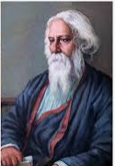
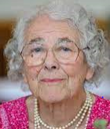
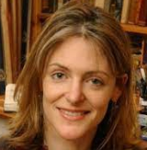
Welcome to Year 2
Judith Kerr
Mrs Kaur
Mr Bali (Friday)
Mini Grey
Miss Yasmin
Radindranath Tagore
Miss Iqbal
The children will be learning about their inspirational author,
so please ask them to tell you what they have learnt.
Notes:
Introduce teachers on video ad the class name they will go by.

Slide 2
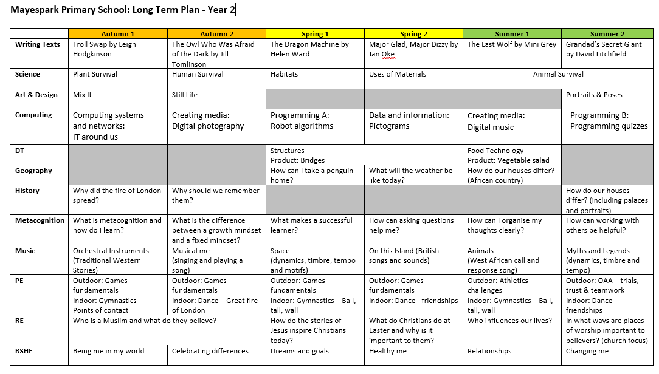
Curriculum
Notes:
LTP is available on website

Slide 3
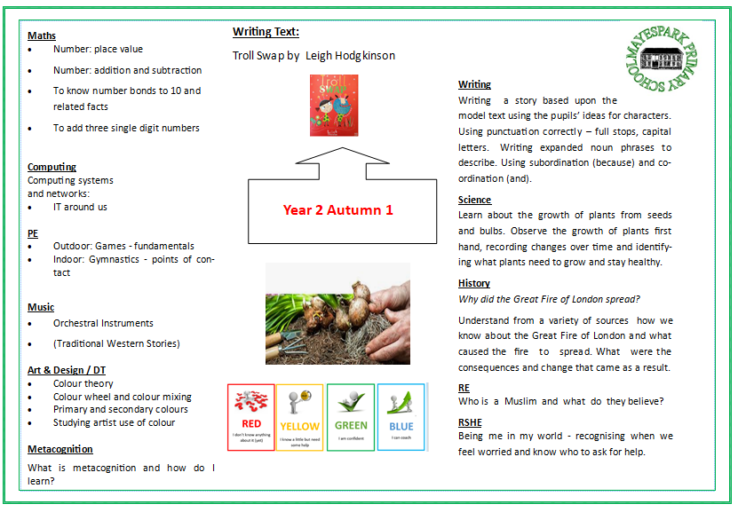
Big Picture Here you can find information about what we will be teaching your child in each subject.
Notes:
Each half term children will get a medium term plan. Educational visits,

Slide 4
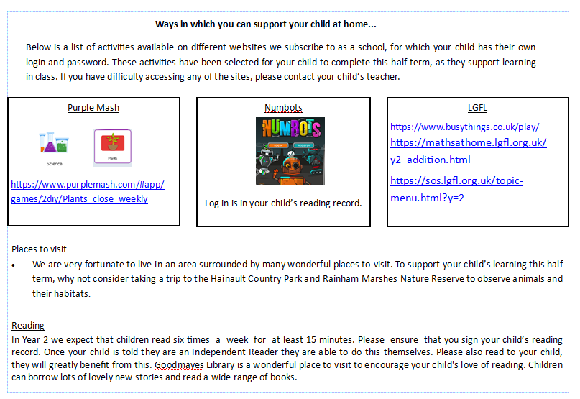
Also there are suggestions of ways you can support your child with their learning at home.

Slide 5
Reading in Year 2.
Throughout the school day your child will have many opportunities to enjoy and listen to stories.
Each day your child will practise reading in their RWI lesson.
They will be listened to read each week by an adult and the teacher will listen to them read at least once every three weeks. The teacher and adult will record what they have read in their home school reading record.
Notes:
Add photos of book corners.

Slide 6
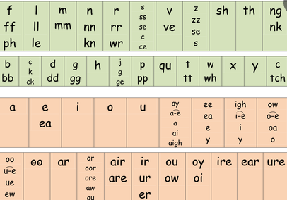
RWI
Everyday your child will have a RWI lesson, where they will continue to learn their sounds and read books that match their phonic knowledge.
Once your child has practised reading a book in their lessons they will bring it home to read to you alongside a phonic decodable book. It is really important that your child has the opportunity to read this daily to you to help improve their fluency and comprehension. Please record daily in their home school reading record that they have practised their RWI book.
Notes:
show

Slide 7
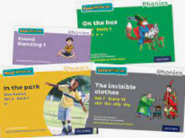
Ways to support your child with reading at home.
Each week your child will bring home at least four books.
Two books will be from our book corners that you can share and read together. It is not expected that your child will be able to read these independently but will enjoy sharing a story with you for pleasure.
In addition they will bring home a colour banded book or two RWI books that they will read to you. This is practised daily for at least 15 minutes and a comment made in the home school reading record.
The home school reading record will be checked each day by the class teacher to check children are engaging and practising reading at home.
Taking your child regularly to the library is a wonderful opportunity to improving their reading. Here they can select books that interest and excite them and develop their passion for reading.
Extend your child’s vocabulary, e.g. instead of saying,” Look at that big dog? ”
We could say “Look over there, can you see the enormous dog wagging its tail? It looks
exhausted and thirsty.”
Notes:
Show journals and an example of the book.s

Slide 8
Home school reading record The home school reading record will be checked every morning to check that your child has read at home and it has been signed by an adult. Rewards are given each week to children who have read daily at home.
Your child’s reading target will also be in the record so that they can practise this target at home.
In the reading record you will find useful questions to ask your child as well as sounds and words to
practise.
Notes:
Show journal and what is inside and how to set it our. Explain the targets.

Slide 9
Expectations of reading
Notes:
Explain this grid will be in the journals to refer to.

Slide 10
Recommended reading in Year 2

Slide 11
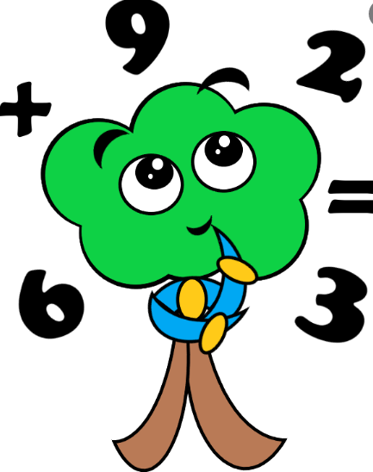
Maths in year 2
Ways to support your child in maths.
Counting forwards and backwards in ones to 100
Counting in 2’s, 5’s and 10’s both forwards and backwards.
Practise writing both the numeral and word e.g. 9, nine.
Playing a variety of games.
https://www.topmarks.co.uk/maths-games/hit-the-button
https://www.ictgames.com/
Each week your child will get maths homework which will be a reflection of what they have learnt that week.

Slide 12
Notes:
to support the development of the mental fluency skills that underpin much of the mathematics curriculum children will be working on a specific maths target each term.. Parents will be informed of this target with the big picture and there will be ways you can support your child on the target sheet. It is important your child practises regularly so that they can recall these facts instantly. This term we are working on ……

Slide 13
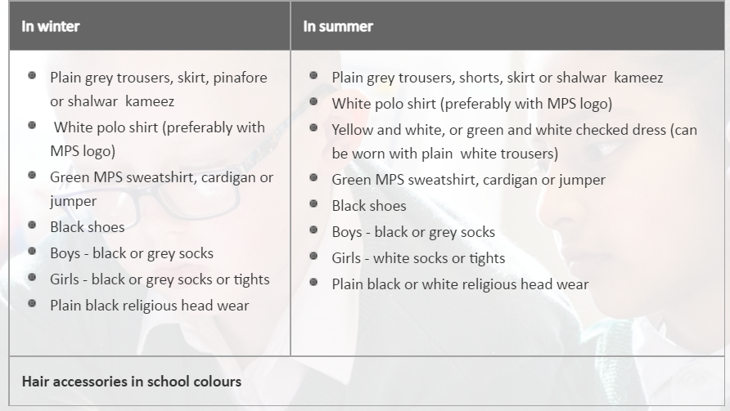
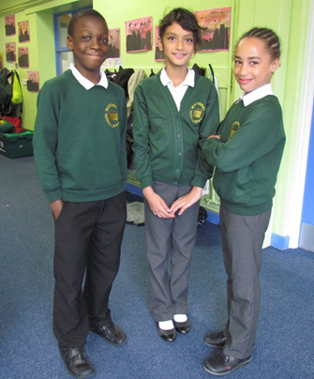
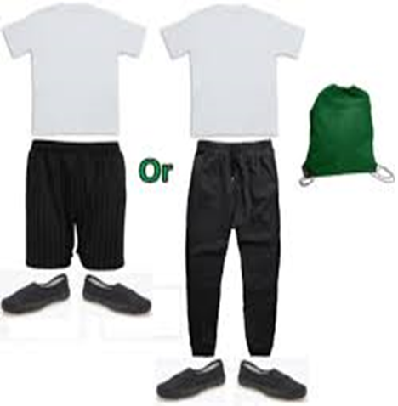
Uniform Expectations
PE Kits
Please ensure PE kits are in school everyday and all uniform has your child’s name on it.
Notes:
Bring each day, hoping to go back to visits JUMPERS names

Slide 14
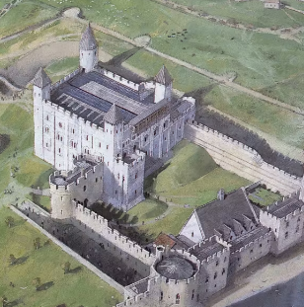
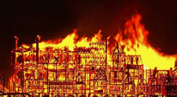
Educational visits
In the autumn term we are hoping to the
Tower of London to explore key features of the
Great Fire of London.
There will be more exiting trips planned throughout the spring and summer term.

Slide 15
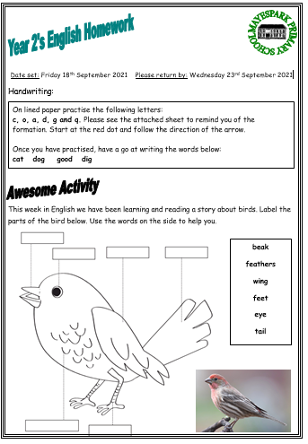
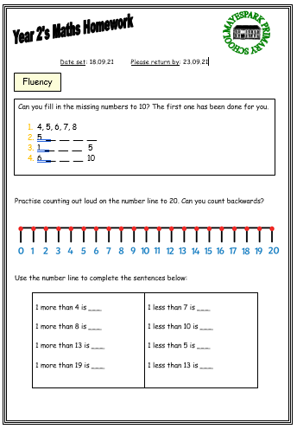
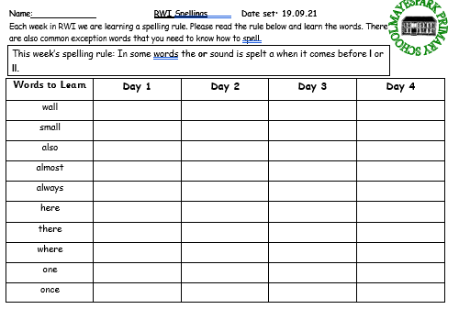
Homework
Homework is set on Google Classroom. Each child has a log in but please ask your class teacher if you don’t have one.
Home work will begin the week starting the 16th September.
Each week their will be a piece of English to complete that reflects their learning for that week. Maths will be set on ‘MyMaths’ website.
Please hand the book in to the class teacher who will mark the work and hand it back to you.
Homework is set on a Friday and handed in by the following Wednesday.
In addition every week there will be spellings sent home by your child’s RWI teacher
A spelling test will be on Thursday and new spellings
will be sent home on Friday.
Notes:
Google classroom, English maths spellings, take photo starts 13th sept.
Complete in yellow home work books.

Slide 16
Communication
Class teachers are always happy to help with any queries.
Please contact the office via email or call to arrange an appointment.
Translation is available for any parents who need this support.
Parents’ Evening dates will be available on the school diary.

